Slide 1
CLASS : V SUB:MATHEMATICS CHAPTER: ROUNDING OFF NUMBERS

Slide 3
REAL LIFE EXAMPLES OF ESTIMATION/ROUNDING OFF

Slide 4
What is Rounding Off ?
Defination 1 : Rounding off means a number is made simpler by keeping its value intact but closer to the next number. It is done for whole numbers, and for decimals at various places of hundreds, tens, tenths, etc. Rounding off numbers is done to preserve the significant figures.
Defination 2 : Rounding means making a number simpler but keeping its value close to what it was. The result is less accurate, but easier to use.

Slide 6
Rounding off to the nearest 10
Rounding: To replace a number with a number that tells about how many to the nearest ten, hundred, thousand, and so on.
Example:
27 is closer to 30, so we would round it to 30!
Place value: The value given to the place a digit has in a number.
20 21 22 23 24 25 26 27 28 29 30
Notes:
Review place value.
Practice using the halfway point.

Slide 7
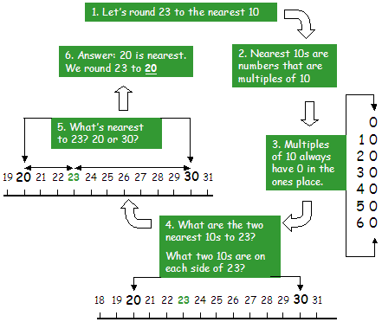
Rounding off to the nearest tens(pictorial view)
Rule
A large number may be rounded off to the nearest 10. 1. While rounding off to the nearest ten if the digit in the units place is between 0 – 4 i.e., < 5 then the unit digit is replaced by 0. 2. If the digit in the units place is 5 to 9 i.e., > or 5 but < 10, then the units place is replaced by ‘0’ and the tens place increased by 1.

Slide 9
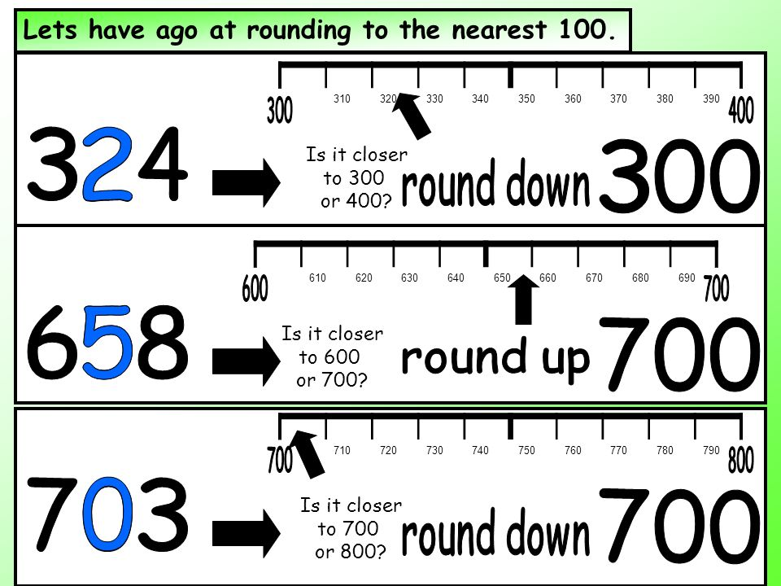
Rounding off to the nearest hundred
1. While rounding off to the nearest hundred, if the digit in the tens place is between 0 – 4 i.e. < 5, then the tens place is replaced by ‘0’. 2. If the digit in the units place is equal to or >5, then the tens place is replaced by ‘0’ and the hundreds place is increased by 1.

Slide 10
We just rounded 2,372 to the nearest hundred.
The nearest hundred is 2,400.
x
2,300
2,350
2,400
2,372
2,372 is closer to 2,400 rather than 2,300.
Notes:
Rounding Rap makes it easy to find the closest hundred. We can use Rounding Rap to help us round whole numbers.
We will practice rapping together as a class. I usually tie a bandana around my head and pretend that I am rapping into a microphone. I also walk around the room making rapping sounds. The students really get a kick out of this and we have a lot of fun while learning how to round!

Slide 11
VIDEO
Steps to open the video
Click on the right button of the mouse on title video
Click on the option open hyperlink
You will be able to see the video

Slide 12
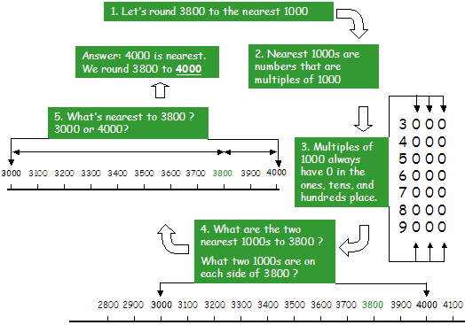
Rounding off to the nearest Thousand
1. While rounding off to the nearest thousand, if the digit in the hundreds place is between 0 – 4 i.e., < 5, then the hundreds place is replaced by ‘0’. 2. If the digit in the hundreds place is = to or > 5, then the hundreds place is replaced by ‘0’ and the thousands place is increased by 1.

Slide 13
Rounding6,721to the nearest THOUSAND
6,721
Notes:
Go through the steps of the Rounding Rap and show my work as I go through the steps.
Students can follow along on their individual white boards as I go through the steps. I will also call students up to the board to help me.

Slide 17
ROUNDING OFF DECIMAL NUMBERS

Slide 18
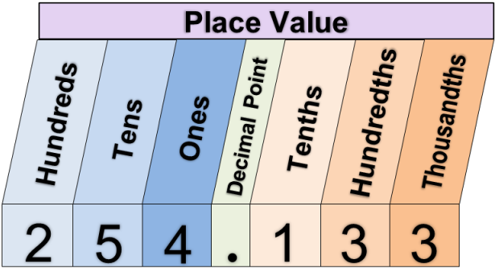
Learning Objective
We will round decimals.
What are we going to do?
CFU
Place value: The place is the position of a digit in a number.
The value is the worth of the digit due to its position.
1. What is the value of the digit 7?
9 3 6. 7 1
0.7
The value of 7 in 936.71 is _______.
Students, you already know how to identify the place value of numbers. Now, we are going to use place value to round decimals.
Make Connection
2. What is the value of the digit 6?
9 7. 5 2 6
0.006
The value of 6 in 97.526 is _______.

Slide 19
Skill Development/Guided Practice (continued)
To round a decimal number is to change it to a near value.
Rounding down changes the number to a lesser value.
Rounding up changes the number to a greater value.
Round decimals.
1
Read the problem and identify the place value to round to. (circle)
Label the number line with the appropriate numbers.
Place the given number on the number line.
Round the number up or down.
Interpret your answer. (write)
2
3
4
5
5. Round to the nearest one. 98.604 __________ rounded to the nearest one is ________ because ______________________________ ______________________________. | 6. Round to the nearest one. 87.506 __________ rounded to the nearest one is ________ because ______________________________ ______________________________.
98.604
87.506
98
98.5
99
87
87.5
88
98.604
87.506
99
88
it is nearer in value to 99 than 98.
it is nearer in value to 88 than 87.

Slide 20
To round a decimal number is to change it to a near value.
Rounding down changes the number to a lesser value.
Rounding up changes the number to a greater value.
Rounding Decimals
Round 82.53 to the nearest tenth.
82.53
82.5
82.55
82.6
82.53 rounded to the nearest tenth is 82.5 because it is nearer in value to 82.5 than 82.6.
Round 82.53 to the nearest one.
82.53
82
82.5
83
82.53 rounded to the nearest one is 83 because it is nearer in value to 83 than 82.

Slide 21
Skill Development/Guided Practice (continued)
To round a decimal number is to change it to a near value.
Rounding down changes the number to a lesser value.
Rounding up changes the number to a greater value.
Round decimals.
1
Read the problem and identify₁ the place value to round to. (circle)
Label the number line with the appropriate₂ numbers.
Place the given number on the number line.
Round the number up or down.
Interpret₃ your answer. (write)
2
3
4
5
3. Round to the nearest tenth. 48.640 __________ rounded to the nearest tenth is ________ because ______________________________ ______________________________. | 4. Round to the nearest tenth. 67.530 __________ rounded to the nearest tenth is ________ because ______________________________ ______________________________.
48.640
67.530
48.6
48.65
48.7
67.5
67.55
67.6
48.640
67.530
48.6
67.5
it is nearer in value to 48.6 than 48.7.
it is nearer in value to 67.5 than 67.6.

Slide 22
Skill Development/Guided Practice Part 1
To round a decimal number is to change it to a near value.
Rounding down changes the number to a lesser value.
Rounding up changes the number to a greater value.
Round decimals.
1
Read the problem and identify₁ the place value to round to. (circle)
Label the number line with the appropriate₂ numbers.
Place the given number on the number line.
Round the number up or down.
Interpret₃ your answer. (write)
2
3
4
5
Round to the nearest hundredth. 45.327 __________ rounded to the nearest hundredth is ________ because ______________________________ ______________________________. | 2. Round to the nearest hundredth. 36.428 __________ rounded to the nearest hundredth is ________ because ______________________________ ______________________________.
45.327
36.428
45.32
45.325
45.33
36.42
36.425
36.43
45.327
36.428
45.33
36.43
it is nearer in value to 45.33 than 45.32.
it is nearer in value to 36.43 than 36.42.

Slide 24
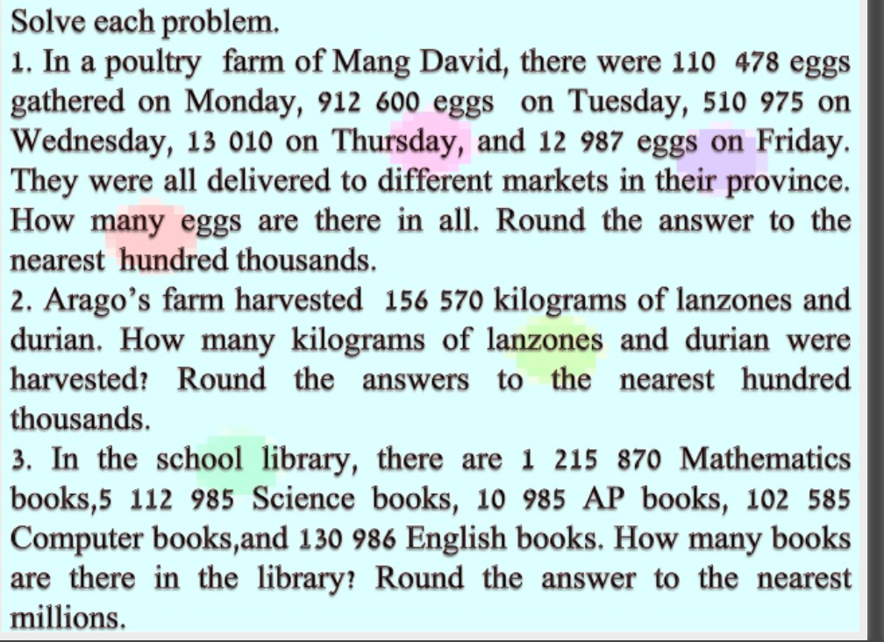

Slide 25
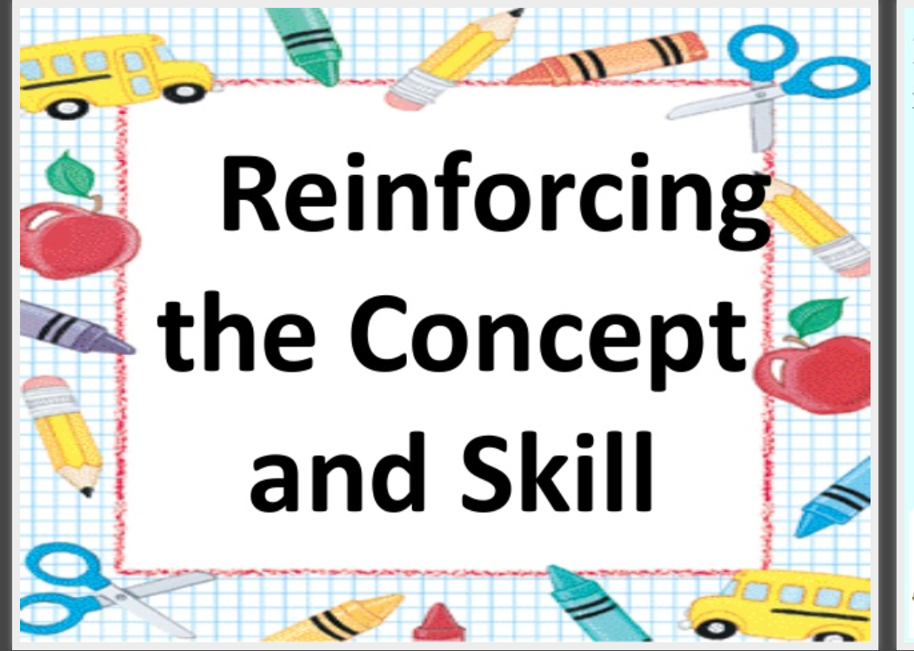

Slide 28
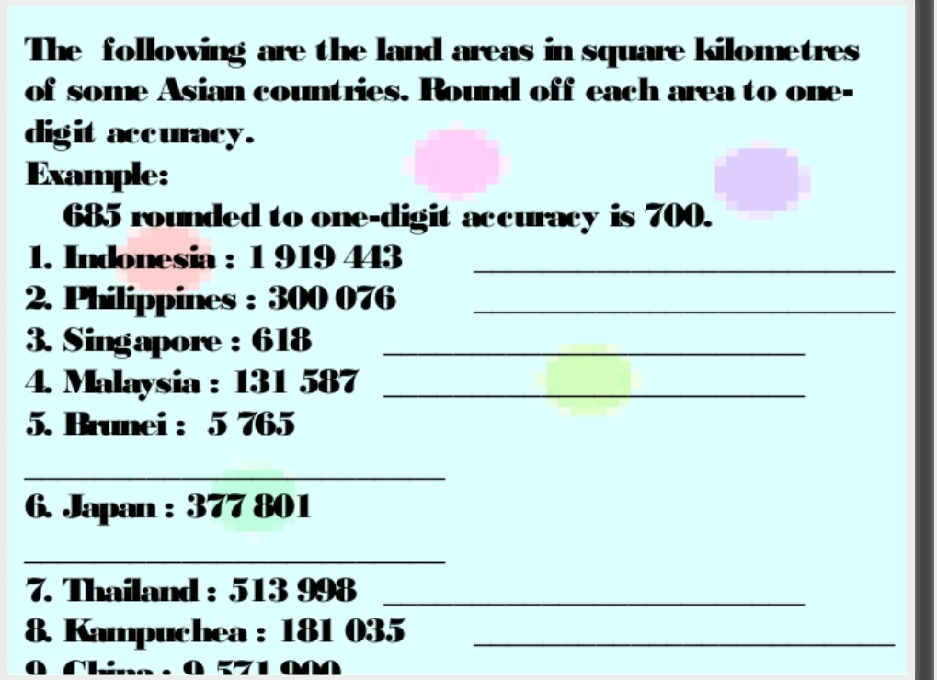

Slide 31
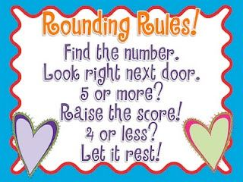
Rounding Poem
Follow the rule ,then you will rule.

Slide 33
HAVE A GREAT DAY AHEAD !

